Slide 1
Best practices

Slide 2
John Papas style guide
https://github.com/johnpapa/angular-styleguide

Slide 3
One component per file
DO
user - controller.js
product - controller.js
DONT
controllers.js

Slide 4
Project structure
app features users user.controller.js user.tmpl.js user.scss user.routes.js .. next feature ... bootstrapping.js config.js constants.js values.js app.scss specs/ assets/ libs/ dist/ Gulpfile.js karma.conf.js

Slide 5
Watch expressions
<div ng-repeat="service.getUser()"
<div ng-model="expression"
$scope.prop
$scope.$watch('scopeprop', function(){
})
Keep track of watchers, there is a limit
https://github.com/pkaminski/digest-hud
2000 is the limit

Slide 6
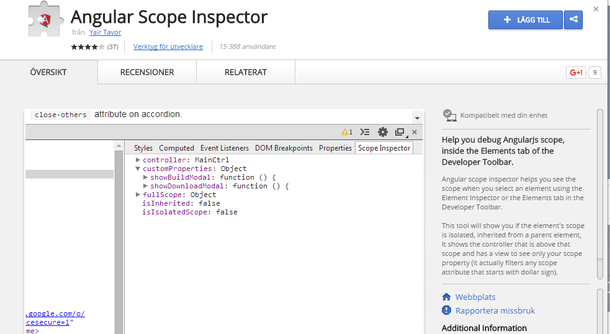
Debugging
Debugging Look at scope inspector to see what your scope contains https://chrome.google.com/webstore/detail/angular-scope-inspector/aaglpchhlnofjbbpopfdfgllfkhnljnl

Slide 7
Bindings ng-bind When you dont want to display data until its there ng-bind="prop" ng-bind-template="{{prop}} ({{prop2}})" Better than {{prop}} one time binding :: Angular defaults to two-binding, this is expensive. Use one-time ng-repeat=item in ::items" {{ ::prop }}

Slide 8
ng-if vs ng-show ng-if removes from DOM, better for memory unless you want to preserve state GOOD <div ng-if="prop"> MIGHT BE BAD, if you want to keep inner state <directive ng-if="prop"

Slide 9
Styling Two supported ways: ng-class="a > b ? 'class' : ''" ng-class="{ a>b : 'class', b > c : 'class2' }" The last version is the only one that is guarenteed to be supported

Slide 10
Dependency injection DONT
angular.module('app').factory('service',function(userService, user){ }); This will break in minification unless you run ng-annotate
BETTER angular.module('app').factory('service',['userService','user',function(userService, user){ }]);
BEST - more readable, this is what minification does anyway angular.module('app').factory('service',Service); Service.$inject = ['userService','user']; function Service(userService, user){ }

Slide 11
Watch expression DONT var deepWatch = true; $scope.$watch('obj', deepWatch) use appropriate watch $watchCollection(scopeprop, function(){ // something was added or removed }) $watch('prop + prop2') OR $watchAll(['prop','prop2'], function(){ })
Watch a collection
Watch more than one property

Slide 12
Dont pollute the global namespace
(function(module) { 'use strict'; module.controller('appCtrl', AppCtrl); AppCtrl.$inject = ['$scope']; function AppCtrl($scope){ } })(angular.module('app'));
Use strict to make it adhere to linting rules
Self executing function to make it ”private”

Slide 13
Nestled scopes – use this and controllerAs
div ng-controller="controller as cm"> <div ng-controller="childcontroller as child"> {{ cm.prop }} {{ child.prop }} <div> </div> angular.module(’app’).('controller', function(){ this.prop = 'prop2' });
Prevent shadowing and make it more
clear which property I mean
this instead of scope

